Slide 1
Design and Analysis of Algorithms
Algorithms-II : CS345A
Website: hello.iitk.ac.in
Lecture 6
Proof of correctness of an algorithm

Slide 2
Motivation
Study this lecture slowly, steadily, and try to answer each question posed in the slides.
Revisit this lecture whenever you want a better understanding of proof of correctness.
Algorithm designed for a problem is incomplete unless its correctness is established.
An algorithm without proof of correctness is just a heuristic.
As an important part of the course, one must have a fair amount of the understanding about proof of correctness of an algorithm.
Many times, one is not even clear about what claim one needs to prove to establish correctness of an algorithm. For every algorithm we study, there is
A formal and usually short proof of correctness.
There is no formula for proof of correctness of an algorithm.
The proof of correctness is based only on a better insight into the algorithm.
In this way, a proof just demands a better understanding of the algorithm.
It is hoped that from this lecture, you will be motivated to write short, and yet precise and formal proof of correctness for every algorithm you design.

Slide 3
Correctness of an algorithm
For every valid input,
the algorithm outputs a correct answer.

Slide 4
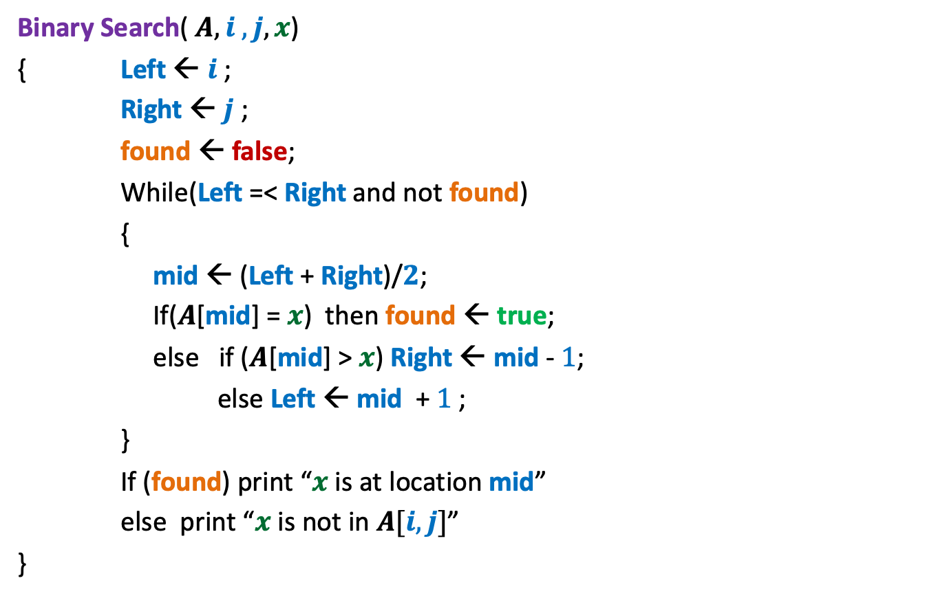
Binary Search
Binary Search( $A, i , j, x$)
{ Left ← $i$;
Right ← $j$ ;
found ← false;
While(Left =< Right and not found)
{
mid ← (Left + Right)/$2$;
If($A$[mid] = $x$) then found ← true;
else if ($A$[mid] > $x$) Right ← mid - $1$;
else Left ← mid + $1$;
}
If (found) print “$x$ is at location mid”
else print “$x$ is not in $A[i,j]$”
}
How did you establish the correctness of this algorithm : By successfully running it on some inputs ?
was that enough ?

Slide 5
Correctness of an algorithm
Almost every algorithm we study in this course, there is
A short and formal proof of correctness.
No formula for proof of correctness of an algorithm.
The proof of correctness is based only on insights into the algorithm.

Slide 6
Binary Search

Slide 7
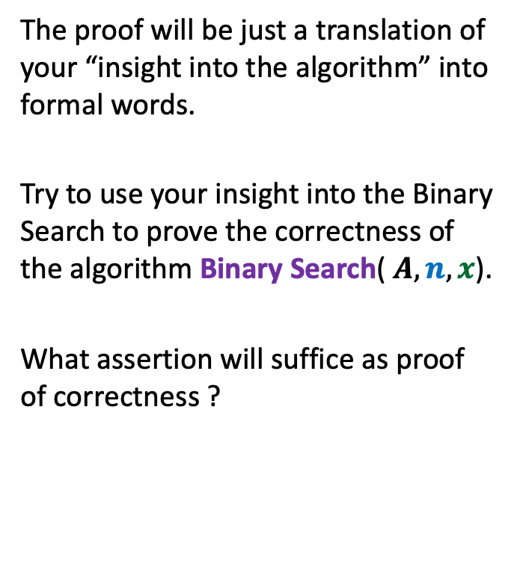
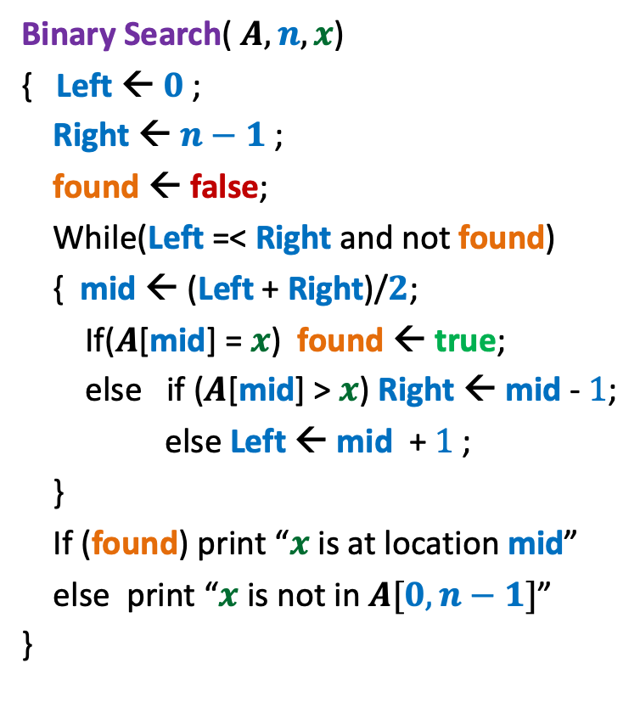
Binary Search
Binary Search( $A, n, x$)
{ Left ← $0$;
Right ← $n−1$ ;
found ← false;
While(Left =< Right and not found)
{ mid ← (Left + Right)/$2$;
If($A$[mid] = $x$) found ← true;
else if ($A$[mid] > $x$) Right ← mid - $1$;
else Left ← mid + $1$;
}
If (found) print “$x$ is at location mid”
else print “$x$ is not in $A[0,n−1]$”
}
The proof will be just a translation of your “insight into the algorithm” into formal words.
Try to use your insight into the Binary Search to prove the correctness of the algorithm Binary Search( $A, n, x$).
What assertion will suffice as proof of correctness ?

Slide 8

Binary Search
Binary Search( $A, n, x$)
{ Left ← $0$;
Right ← $n−1$ ;
found ← false;
While(Left =< Right and not found)
{ mid ← (Left + Right)/$2$;
If($A$[mid] = $x$) found ← true;
else if ($A$[mid] > $x$) Right ← mid - $1$;
else Left ← mid + $1$;
}
If (found) print “$x$ is at location mid”
else print “$x$ is not in $A[0,n−1]$”
}
Assertion 1:
If (not found) then $x∉$ $A[0,n−1]$.
Left
Right
Left
Right
Left
Right

Slide 9
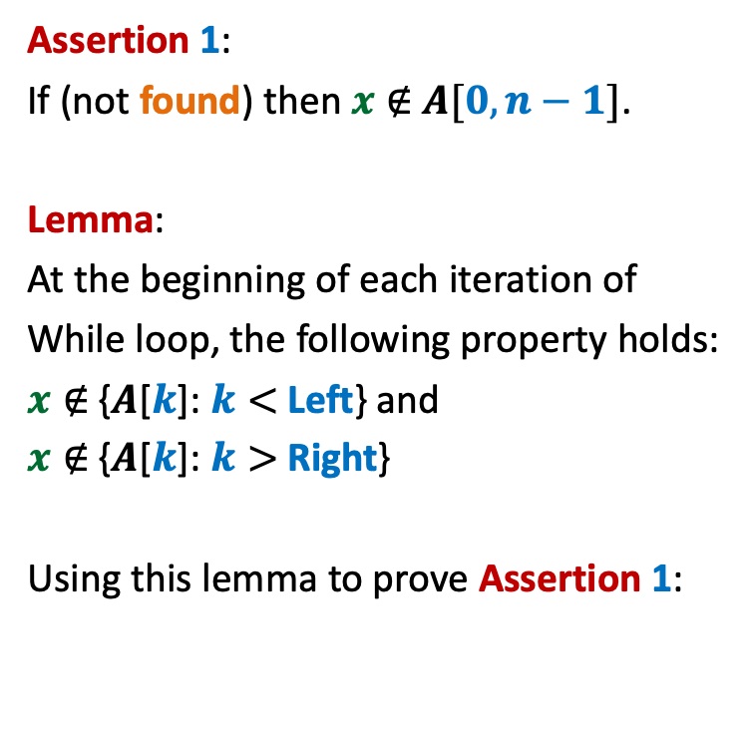
Binary Search
Binary Search( $A, n, x$)
{ Left ← $0$;
Right ← $n−1$ ;
found ← false;
While(Left =< Right and not found)
{ mid ← (Left + Right)/$2$;
If($A$[mid] = $x$) found ← true;
else if ($A$[mid] > $x$) Right ← mid - $1$;
else Left ← mid + $1$;
}
If (found) print “$x$ is at location mid”
else print “$x$ is not in $A[0,n−1]$”
}
Assertion 1:
If (not found) then $x∉$ $A[0,n−1]$.
Lemma:
At the beginning of each iteration of
While loop, the following property holds:
$x∉$ {$A$[$k$]: $k<$ Left} and
$x∉$ {$A$[$k$]: $k>$ Right}
Using this lemma to prove Assertion 1:
Left
Right
Right
Left

Slide 10
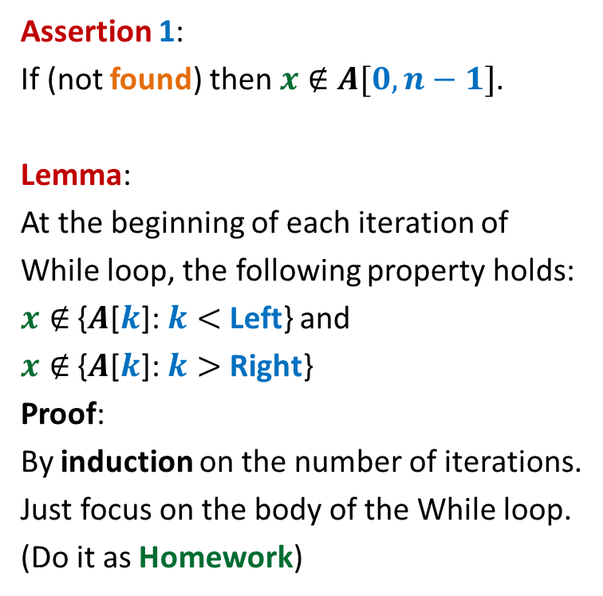
Binary Search
Binary Search( $A, n, x$)
{ Left ← $0$;
Right ← $n−1$ ;
found ← false;
While(Left =< Right and not found)
{ mid ← (Left + Right)/$2$;
If($A$[mid] = $x$) found ← true;
else if ($A$[mid] > $x$) Right ← mid - $1$;
else Left ← mid + $1$;
}
If (found) print “$x$ is at location mid”
else print “$x$ is not in $A[0,n−1]$”
}
Assertion 1:
If (not found) then $x∉$ $A[0,n−1]$.
Lemma:
At the beginning of each iteration of
While loop, the following property holds:
$x∉$ {$A$[$k$]: $k<$ Left} and
$x∉$ {$A$[$k$]: $k>$ Right}
Proof:
By induction on the number of iterations.
Just focus on the body of the While loop.
(Do it as Homework)
Loop Invariant

Slide 11
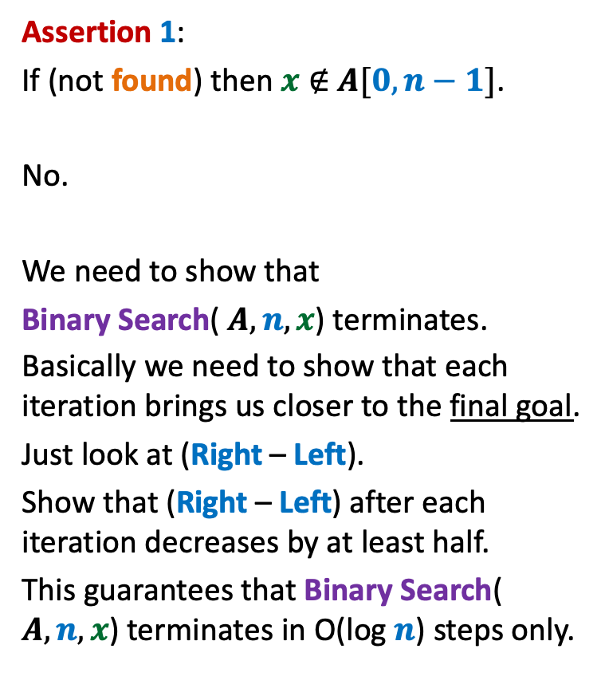
Binary Search
Binary Search( $A, n, x$)
{ Left ← $0$;
Right ← $n−1$ ;
found ← false;
While(Left =< Right and not found)
{ mid ← (Left + Right)/$2$;
If($A$[mid] = $x$) found ← true;
else if ($A$[mid] > $x$) Right ← mid - $1$;
else Left ← mid + $1$;
}
If (found) print “$x$ is at location mid”
else print “$x$ is not in $A[0,n−1]$”
}
Assertion 1:
If (not found) then $x∉$ $A[0,n−1]$.
No.
We need to show that
Binary Search( $A, n, x$) terminates.
Basically we need to show that each iteration brings us closer to the final goal.
Just look at (Right – Left).
Show that (Right – Left) after each iteration decreases by at least half.
This guarantees that Binary Search( $A, n, x$) terminates in O(log $n$) steps only.
Are we done ?

Slide 12
Synchronizing a circuit
with minimum delay enhancement

Slide 13
An Electric Circuit
A complete binary tree
Electric signal originates at the root
Signal passing through each edge incurs a delay (a few nano seconds)
Finally signal reaches all the leaves.
Electric signal
6
5
3
2
4
2
2
1
6
2
1
2
3
2
Delay 11 10 14 10 10 11 10 9
14
10

Slide 14
Problem definition
Given:
There is a circuit in the form of a complete binary tree.
Electric signal propagates from root to all leaf nodes.
Each edge has certain delay
The delay in reaching signal to a leaf node =
“sum of delays on all edges on the path from root.”
Objective:
Enhance delay along certain edges so that
The delay on all paths from root to leaf nodes is the same.
Total delay enhancement is minimum.
What is the first step for designing an algorithm ?

Slide 15
Working on an Example

Slide 16
Working on an Example
How to achieve 1st Objective:
Synchronizing all paths from the root?
+4 is necessary and sufficient as well ☺
What algorithm comes to your mind based on this inference ?
Electric signal
Spend some time on this portion to see if you can reduce the total delay ?
Total delay enhancement: 27
6
5
How much enhancement is needed for this edge ?
3
2
4
2
2
1
6
2
1
2
3
2
+3 +4 +4 +3 +4 +5
+4
Delay 11 10 14 10 10 11 10 9
New Delay 14 14 14 14 14 14 14 14
Is this the minimum delay enhancement ?

Slide 17
Working on an Example
What algorithm comes to your mind based on this inference ?
Electric signal
Total delay enhancement: 27
6
5
3
2
4
2
+4
2
1
6
2
1
2
3
2
+3 +4 +4 +4 +3 +1
Delay 11 10 14 10 10 11 10 9
New Delay 14 14 14 14 14 14 14 14
➔ 23

Slide 18
Toward designing an algorithm
Electric signal
Total delay enhancement: 14
6
5
+3
3
+3
2
4
2
+1
2
6
+4
1
1
2
+1
3
2
+1
+1
2
14
11
14
14
14 14 14 14
11
11
Delay 11 10 14 10 10 11 10 9
11
10

Slide 19
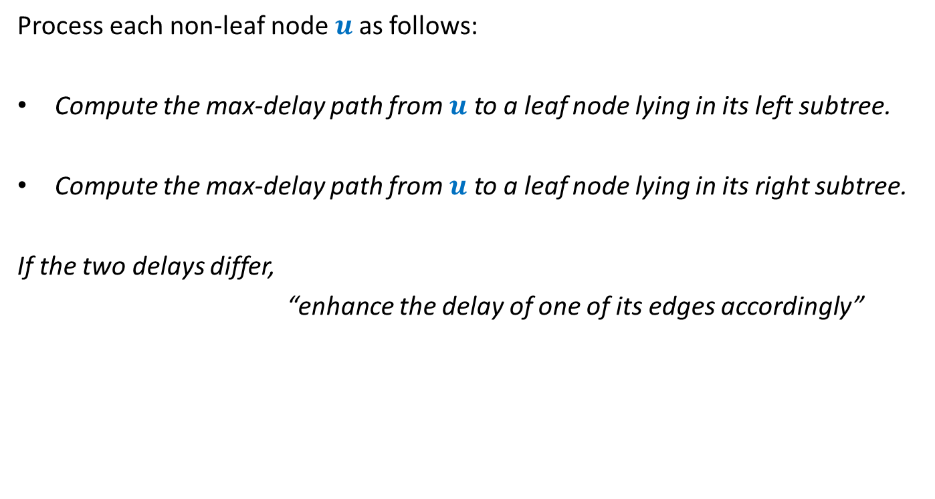
Overview of the proposed algorithm
Process each non-leaf node $u$as follows:
Compute the max-delay path from $u$ to a leaf node lying in its left subtree.
Compute the max-delay path from $u$ to a leaf node lying in its right subtree.
If the two delays differ,
“enhance the delay of one of its edges accordingly”
We need to describe this step more formally. ☺

Slide 20








For each non-leaf node $u$ do the following:
$D_{L}(u)$: max delay along any leftward path
$D_{R}(u)$: max delay along any rightward path
If ($D_{L}\left(u\right)≥D_{R}(u)$)
increase delay of right edge by $D_{L}\left(u\right)$ - $D_{R}\left(u\right)$
Else
increase delay of left edge by $D_{R}\left(u\right)$ - $D_{L}\left(u\right)$
$$γ$$
u
$$α$$
$$β$$
$$+D_{R}\left(u\right)\text{ − }D_{L}\left(u\right)$$
$$+D_{L}\left(u\right)\text{ − }D_{R}\left(u\right)$$
$$D_{L}(u)$$
$$D_{R}(u)$$

Slide 21
Proof of correctness of the algorithm
What assertion suffices as a proof ?

Slide 22
What assertion suffices as a proof ?
Usually it is difficult even to find out the claim whose establishment captures the correctness of the algorithm.☹
In the current algorithm, what might be this claim ?
Let us have a re-look at the algorithm from point of view of a single node .

Slide 23
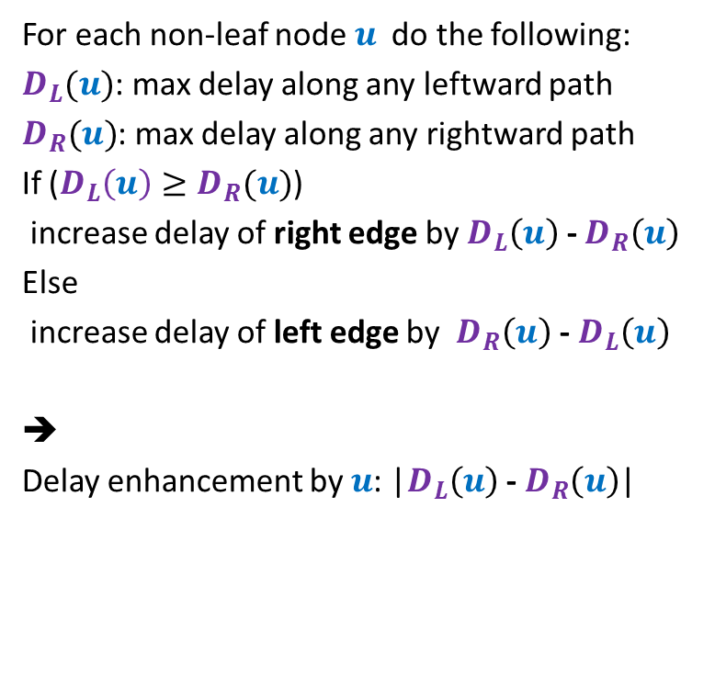



For each non-leaf node $u$ do the following:
$D_{L}(u)$: max delay along any leftward path
$D_{R}(u)$: max delay along any rightward path
If ($D_{L}\left(u\right)≥D_{R}(u)$)
increase delay of right edge by $D_{L}\left(u\right)$ - $D_{R}\left(u\right)$
Else
increase delay of left edge by $D_{R}\left(u\right)$ - $D_{L}\left(u\right)$
➔
Delay enhancement by $u$: |$D_{L}\left(u\right)$ - $D_{R}\left(u\right)$|
$$γ$$
u
$$α$$
$$β$$
$$+D_{L}\left(u\right)\text{ − }D_{R}\left(u\right)$$
$$D_{L}(u)$$
$$D_{R}(u)$$

Slide 24
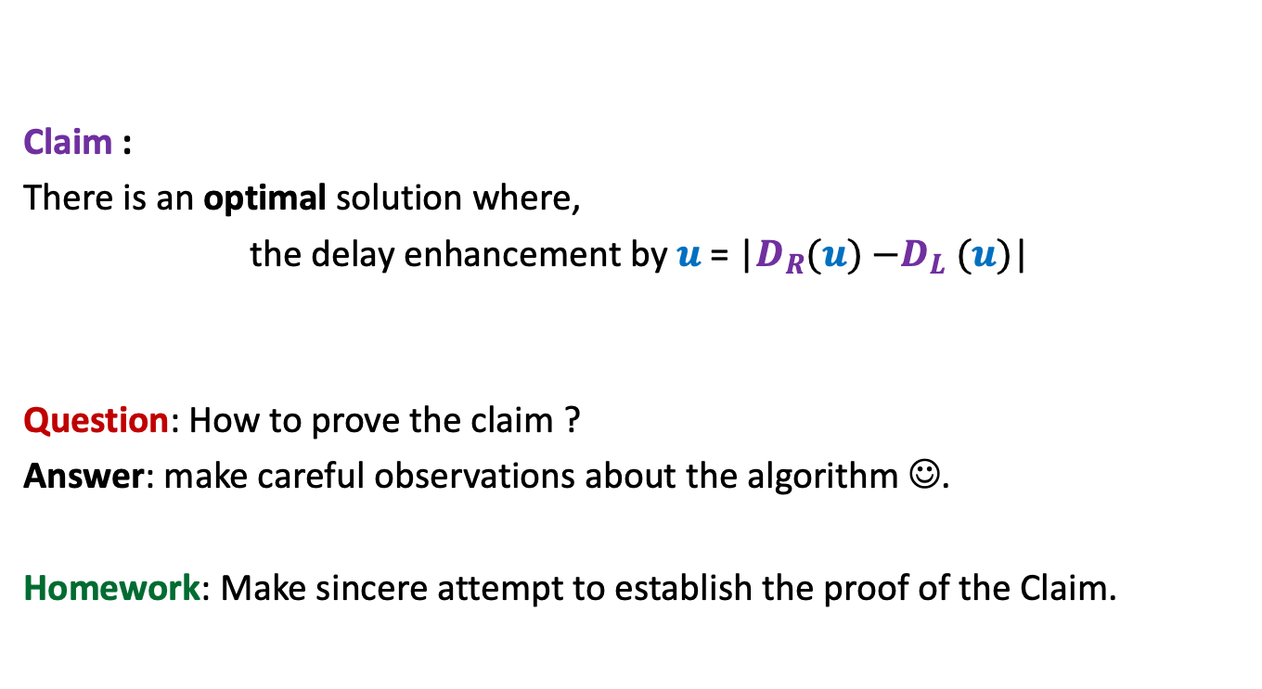
Claim :
There is an optimal solution where,
the delay enhancement by $u$ = |$D_{R}(u){−D}_{L}(u)$|
Question: How to prove the claim ?
Answer: make careful observations about the algorithm ☺.
Homework: Make sincere attempt to establish the proof of the Claim.

